Slide 1
An Introduction to Natural Language Processing
NTU OSS TGIFHacks #121
Siddesh Sambasivam Suseela

Slide 2
Workshop Plan
Introduction
Language Representation
How are words represented?
How are these representations created?
Language Modelling
What is language modelling?
Importance of Language Modelling
Different Types of Language models
Hands-On Exercise
Building a language model
Final Remarks

Slide 3
a classic definition of NLP,
“Natural language processing (NLP) refers to the branch of computer science - and more specifically, the branch of AI concerned with giving computers the ability to understand text and spoken words in much the same way human beings can”

Slide 4
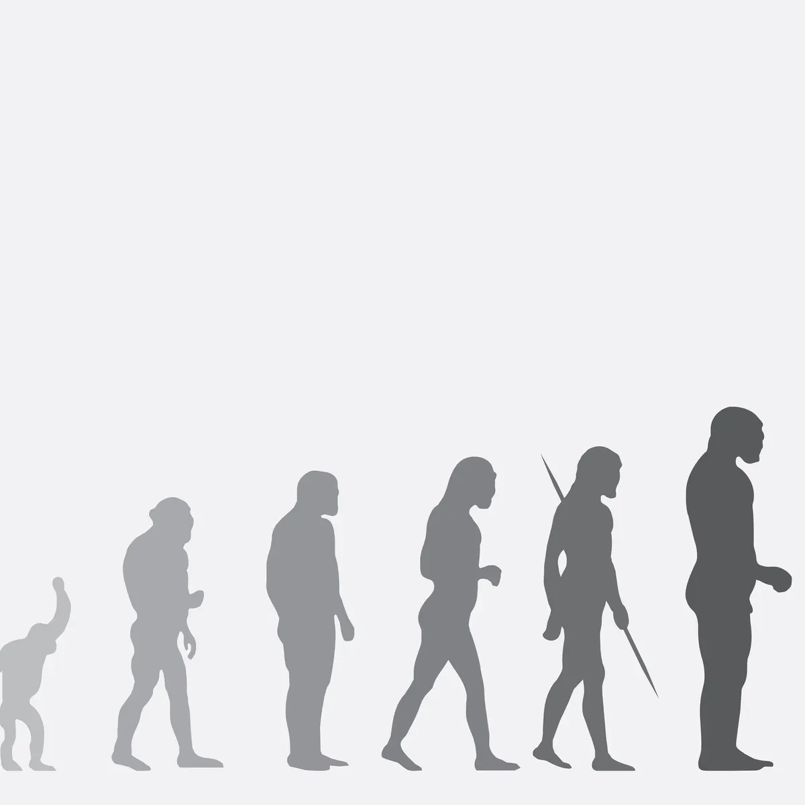
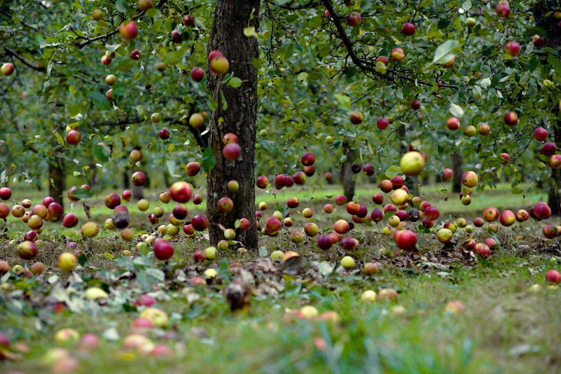
Language as a communication tool
Language allows people to communicate with great precision due to its evolution over time.
But, How?
Language condenses information
Words have specific meanings
Example: Apples are falling from the tree
Example: Human Evolution

Slide 5
How can we represent words?
Encode numerical Values
vocabulary = [Apple, Banana, Phone]
Apple = 1, Banana = 2, Phone = 3
Problem:
Phone is actually not greater than apple or banana
Does not encode the meaning

Slide 6
How can we represent words?
2. Use Vectors - Discrete Values (One Hot Encoding)
Apple = [ 1 0 0 ]
Banana = [ 0 1 0 ]
Phone = [ 0 0 1 ]
Problem:
a. As vocabulary goes higher so does the vector size and computation.
b. Does not really convey the meaning of the words.

Slide 7

How can we represent words?
3. Use Vectors - Continuous Values
Represent words using context at which it appears
There are two methods:
a. Statistical Method (Distributional Semantics)
b. Fixed size vectors optimized based on probability
eg: Word2Vec, GloVe

Slide 8
How can we represent words?
Hello world
This is a test sentence
TGIFHacks workshop
Word2Vec
Hello [0.321, 0.312, …, 0.663]
world [0.421, 0.812, …, 0.163]
This [0.621, 0.712, …, 0.463]
.
.
https://projector.tensorflow.org/
http://jalammar.github.io/illustrated-word2vec
Clarifications: word representations => word vectors = word embeddings

Slide 9
Language Modeling
Q. What is language modeling?
(1) Hello! My ______ is BERT!
(2) He is ________.
name
sleeping | eating | ...
Formal Definition: A task is to predict the next word in a given sentence.

Slide 10
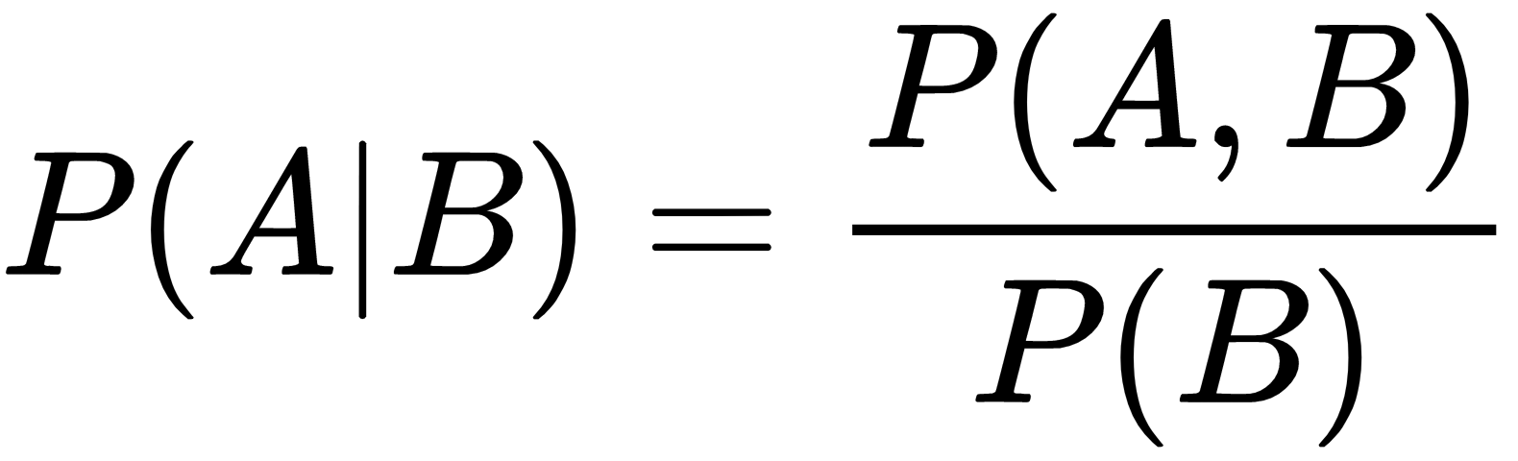
Quick Revision: Conditional Probability

Slide 11
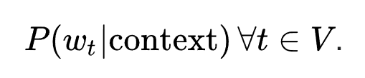
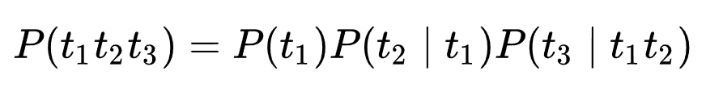
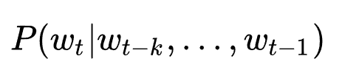
Mathematical Definition….
→ This is what our language model does

Slide 12

Language Modeling
What is the importance of language modeling?
Benchmark task to measure the understanding of the language
Can be used as the base model to train for downstream tasks such as
sentiment analysis
summarization
question-answering
machine translation, etc..
Ex: Google’s BERT Model

Slide 13
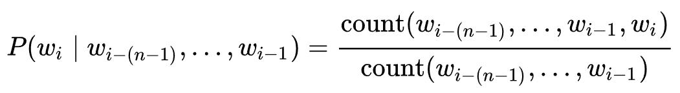
Different types of model
Short Explanation on N-Gram models
Two types:
Statistical Language Models
1 - Gram Model
n - Grams Model
Neural Language Models
Neural Networks
Problems with N-Gram Model:
If a word does not occur with the context in the training data, then it would have probability 0
If the context does not occur at all, then we cannot we find probability for any word

Slide 14
Neural Language Models - A Simple neural networks
is
Probability Distribution for each word in the vocabulary
output layer
Problems with simple neural network:
Context window is small
Size of weight matrix increases
Hidden layer
Input layer
Context Word embeddings
My name ____

Slide 15
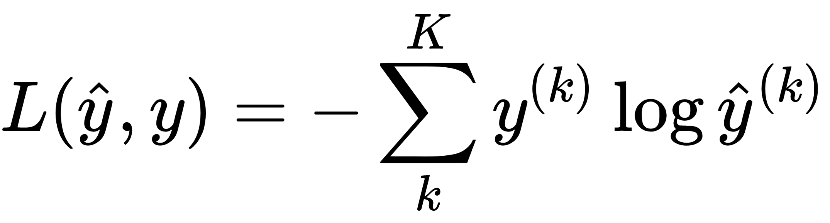
Neural Language Models - Recurrent Neural Network
is
h^{(t)} = func( W_{h}h^{(t-1)} + W_{h}e^{t} + b )
1
Probability Distribution for each word in the vocabulary
^
2
y^{( t )} = softmax( Uh^{(t)} + b)
h⁽⁰⁾
h⁽¹⁾
h⁽²⁾
h⁽³⁾
U
W_{h}
W_{h}
W_{h}
W_{h}
Loss Function
Evaluation metric
Word Embeddings
e¹
e²
e³
e⁴
X₁
X₂
X₃
X₄
Other Models: LSTM, Bi-LSTM, BERT

Slide 16
Quick Recap
Words are represented as dense vectors through optimization
Language modeling (LM) is a task to predict the next word in a given sentence.
LM is a benchmark task to measure the understanding of the language
Different Types of LM models: (1) Statistical LM (2) Neural LM
Discussed Recurrent Neural Networks (RNN)

Slide 17
Hands-On Exercise

Slide 18
Thank you!

